Slide 2
Reasoning Tool
Evidence | This evidence matters because... | Therefore...

Slide 3
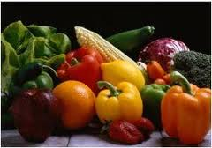
Simple Argument:
Vegetables are good for you.
You should eat them every day.

Slide 4
Simple Argument with Evidence:
Claim: Vegetables are good for you.
Evidence:
Vegetables have vitamins like Vitamin C.
Vegetables have fiber.

Slide 5
Reasoning Tool with Vegetable Argument, One
Evidence | This evidence matters because... | Therefore...
Vegetables have vitamins like Vitamin C |  | Vegetables are good for you.
Vegetables have fiber

Slide 6
Reasoning Tool with Vegetable Argument, Two
Evidence | This evidence matters because... | Therefore...
Vegetables have vitamins like Vitamin C | Eating vegetables and fruits rich in vitamin C may offer protection against immune deficiencies, heart disease, and eye disease. | Vegetables are good for you.
Vegetables have fiber | Eating vegetables with fiber may reduce the risk of heart disease, obesity, and type 2 diabetes.

Slide 7
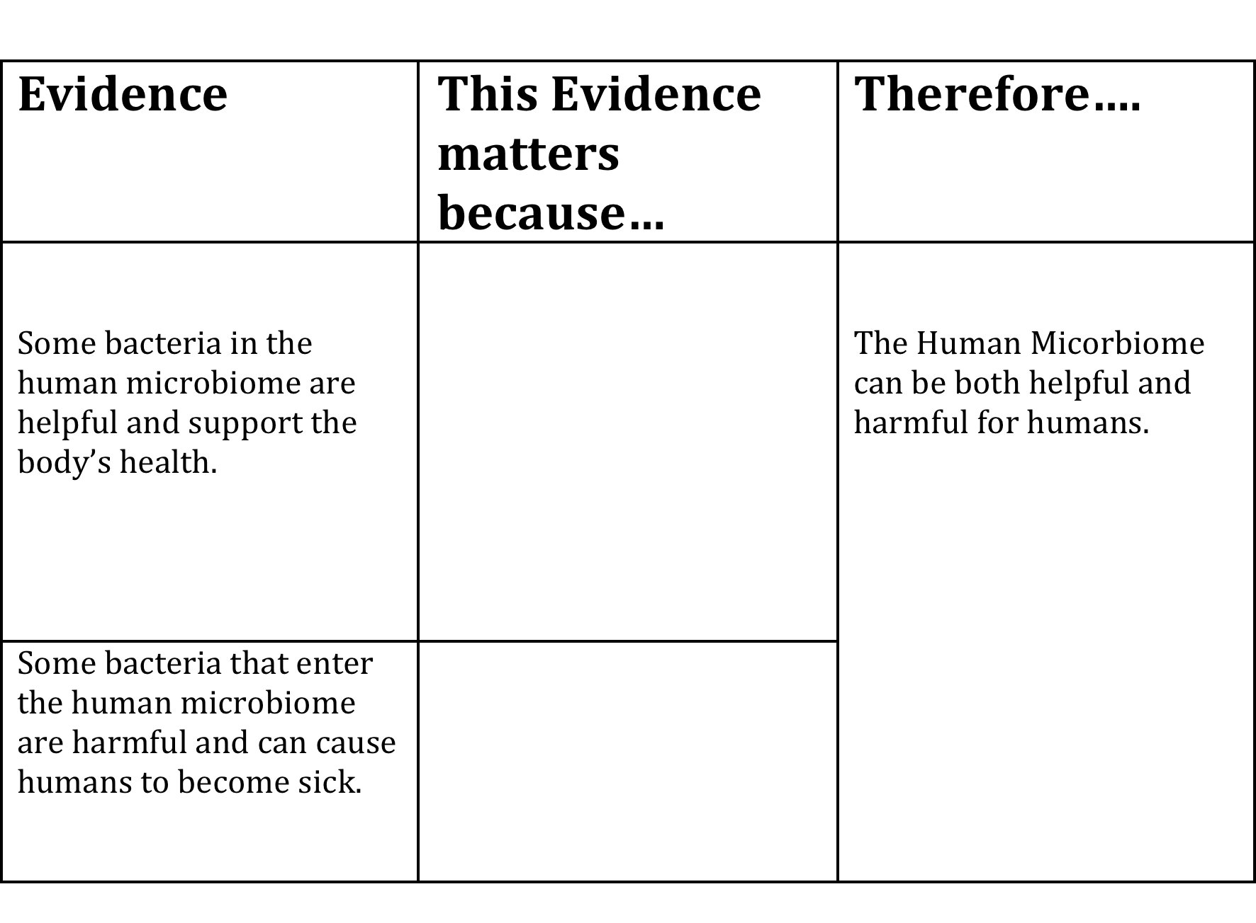
Reasoning Tool with Microbiome Argument

