Slide 1
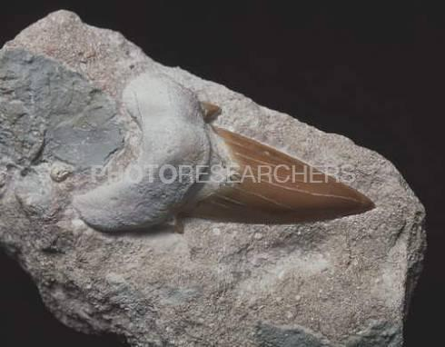
Look at this fossil tooth. What kind of animal might it be from?
Notes:
http://db2.photoresearchers.com/preview/10201664/SA8554.html

